Slide 1
Sharing Experience on Quality Assurance in Higher Education (Round-2):
Thailand Perspective and Lessons for Bangladesh
Quality is not an act. It is a habit.- Aristotle
Presented By: Professor Dr.Muhammad Mahboob Ali
Director, IQAC, Daffodil International University
Presented on:2nd December,2015 at QAU,UGC

Slide 2
Acknowledgement
Government of Bangladesh
Ministry of Education
University Grants Commission, Bangladesh
World Bank
Higher Education Quality Enhancement Project
Asian Institute of Technology,Extension,Thailand
Prof. Dr. Mesbashuddin Ahmed
Prof. Dr. Sanjoy Kumar Adhikary
Prof. Dr. M.Abul Kashem

Slide 3
Time Period: From 18 to 29 November 2015 at AIT extension , Thailand
Total Participants : 18
As an operational activites,15 Directors and Additional Directors of IQAC and 3 officials from QAU,UGC and HEQEP professionally are trained at AIT Extension for 12 days for developing IQA under Round-2 Universities
Initials of the Participants name: MMA, QSH,AD,MNI,MA, TPB, MMR, SNA, MTIM, MNI,SMKA,DNRP, AKMA, MMR,MTH,JP,MMH,GCR

Slide 4
Prelude
Government of Bangladesh set super goal to develop quality education at higher institutions-Vision 2021;

Slide 6
Thai Qualifications Framework (TQF) for Higher Education
5 domains of learning outcomes
Numerical analysis & communication & IT skills
Interpersonal skills & responsibility
Cognitive skills
Ethics and moral
Knowledge

Slide 7
Thai Qualifications Framework (TQF) for Higher Education
Quality assurance system at Higher Education: Administrative and procedural activities executed so that requirements and goals for higher education or activity will be properly fulfilled.
Internal Quality Assessment - Assessors are appointed by the Institutions (Registered by Higher Education Commission) at Thailand.
External Quality Assessment - Assessors are appointed by the Office or National Education
Standards and Quality Assessment (ONESQA) at Thailand.

Slide 8
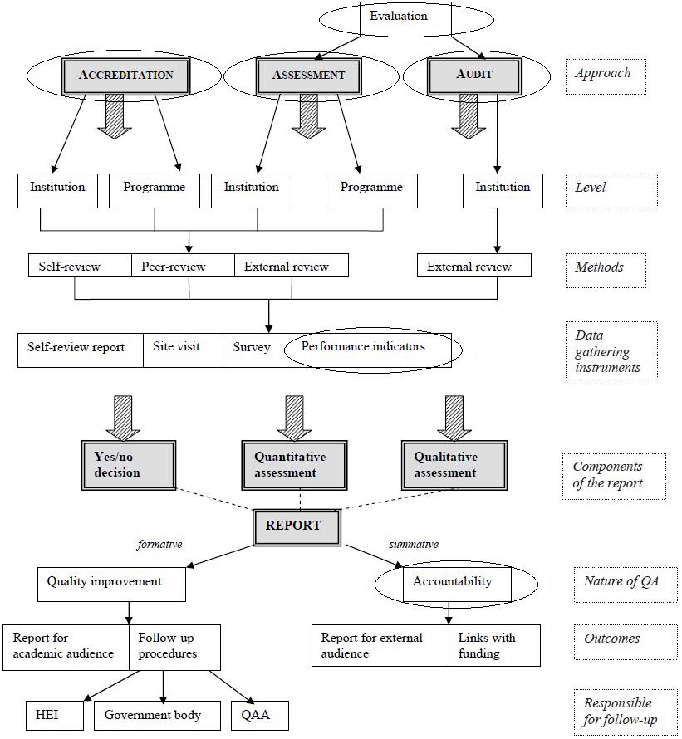
Elements of QAS in HE
Andrea Bernhard: Quality Assurance in an International Higher Education Area

Slide 9
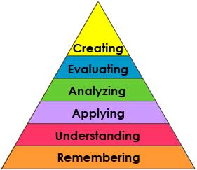
Bloom's Taxonomy(NEW VESION):
http://ww2.odu.edu/educ/roverbau/Bloom/blooms_taxonomy.htm

Slide 10
BANGLADESH PERSPECTIVE
Quality Assurance in Higher Education
Quality management of Higher Education: Requires attention to every details
Input
Process
Output
UGC monitors higher educational institutes.
Professional Bodies, International accreditation councils are also working in some higher educational institutes of Bangladesh.

Slide 11
IQA at Department Level
Criterion 1 Objective and planning Criterion 2 Teaching and learning
Criterion 3 Student development
Criterion 4 Research and Development
Criterion 5 Academic services for social community
Criterion 6 Art and cultural support
Criterion 7 Administration and management
Criterion 8 Quality assurance system
WAY= CONTINUOUS IMPROVEMENT
DETERMINING FACTOR= DEMAND AND SUPPLY OF THE MARKET
END RESULT= EMPLOYABILTY +

Slide 12
PDCA Approach to Write Self Assessment Report
Act
Finalize SAR
Communicate SAR
Get ready
Plan
Communicate intent
Organize team
Develop plan
Understand QA criteria & process
Check
Verify SAR
Gather feedback
Do
Self-assessment
Collect data & evidences
Close gaps
Write SAR
Review SAR

Slide 13
The indicators for the self-assessment of institutional quality are ( Source: Total Quality Management in Education, Third edition, Edward Sallis):
access (5%);
services to customers (5%);
leadership (15%);
physical environment and resources (5%);
effective learning and teaching (20%);
students (15%);
staff (15%);
external relations (5%);
organization (5%);
standards (10%).

Slide 14
Quality Assurance of Teaching & Learning Process: Curriculum design, review & approval process , Teacher Quality, Lesson Plan , Research and Extension, Quality of assurance of assessments/ examinations, stakeholders’ inputs, examiners, students feedback should be taken into cognizance;
Support Staff Quality :Number, type and qualification of support staff, career plan, training plan, appraisal system, award & recognition schemes, student/faculty feedback;
Student Quality : Student selection process, trend of student intakes, credit system, student workload, student performance reports;

Slide 15
Facilities and Infrastructure :Number and type of facilities, utilization rates, downtime/uptime, maintenance plan, new facilities and upgrading plans, safety & health policy, facilities booking system;
Student Advice and Support Mechanisms : to report and feedback on student progress, coaching, mentoring and counseling schemes, student feedback
Constructing yearly action plan : at the Institutional, Department and Program level to achieve quality education through arranging a road map to achieve the target;

Slide 16
Community Services: Students should be encouraged to do community services as a part of academic need;
IT infrastructure: IT infrastructure is the backbone of modern learning system;
Library Facilities: Library facilities should be raised for not only serious students but also those who are not serious students at all;

Slide 17
Art and cultural support: Art and cultural support for the students as well as faculties ought to be arranged; Cultural heritage of 3000 years may be preserved by the universities.
Internationalization: International collaborations , Number of International students, inbound and outbound exchange students ,quality accommodation for international students may be arranged;
Focus: Culture , Innovation, Engagement , and Inclusiveness should be given;

Slide 18
Journals: University may try to index their journals at Scopus listed or similar type of indexed journal; Citation of the works of the faculties at the Scopus listed journal will beneficial for the university;
Industry collaboration : Industry collaboration through consulting and research and extension may be encouraged;

Slide 19
Graduate Employment rate : Quality of Graduates must be at par at regional and global arena so that employment rate can be raised ;
Self –Assessment report: Constructing self-assessment system at the program level , Faculty level and Institutional level;
Cyclical Manner : Each Five year , review of quality process within institution in a cyclical manner should be done;

Slide 20
Internal and External Quality assurance: Effectiveness of Internal and External Quality assurance system is complementary to each other;
National Accreditation Council: Internal review of Quality assurance , external review of quality assurance through forming national accreditation council is required to ensure quality;

Slide 21
Recognition:
Best Higher Educational Institute may get recognition from the Government each year based on Internal and external evaluation and monitoring report;
Best University Teacher of the Country should get National award each year;
Researcher whose article will be published and also cited in Scopus indexed journal may get incentives from their institutes.

Slide 22
Recommendations:
Needs of the country should be identified, indicators should be set up at the institutional level to add value in Global value chain ;
National Accreditation Council should be formed .
Under BIMSTEC (Bay of Bengal Initiative for Multi-Sectoral Technical and Economic Cooperation) a regional body may develop an educational framework like ASEAN University Network.
Sufficient Number of National Assessor for assessing Quality education will have to be appointed;

Slide 23
At the institutional level quality of Administration and management should be improved;
Physical and infrastructural development of Higher educational institutes where underdevelopment prevails , ought to be done without delay;
At the institutional level QS ranking audit may be done for improvement;

Slide 24
THANK YOU

Slide 25
References:
Study materials provided by AIT Extension during the Training program were used.

